Slide 1
Name That Deformation
A new and exciting game for the well-informed geology student!

Slide 2
The idea in this game is to look over the deformation pictured, and try to identify it from the vocabulary in the chapter on geologic deformation. Let’s begin by clicking anywhere on this page for our first example.

Slide 3
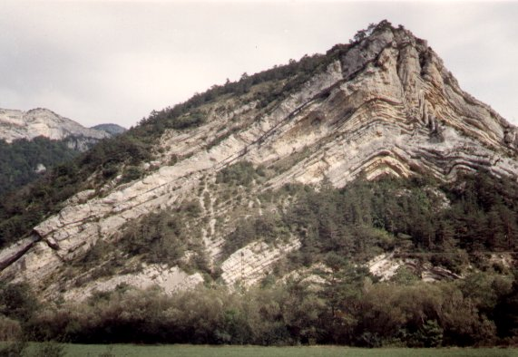
This is an upward fold of strata; found in the Alps.

Slide 4
Did you say “anticline”?

Slide 5
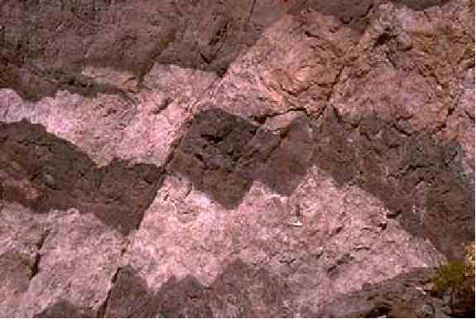
What type of fault is this? Strike-slip or dip-slip?
Click here for a hint!

Slide 6
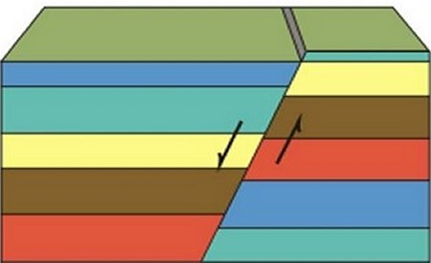
Which one shows vertical displacement?

Slide 7
Hope you said “dip-slip”!

Slide 8
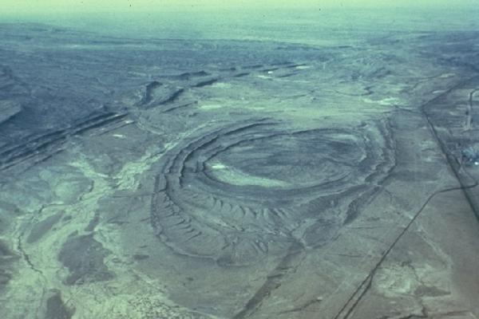
Erosion of upwarped strata like this forms what?

Slide 9
That’s a “dome”!

Slide 10
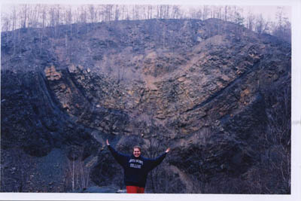
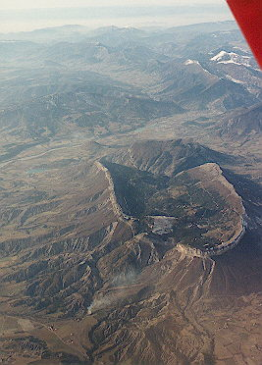
Whether it’s eroded or not, it’s still called a……………….

Slide 11
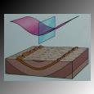

Slide 12
Syncline

Slide 13
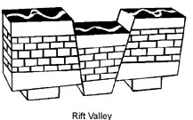
What’s the other name for a rift valley like this?

Slide 14
Graben

Slide 15
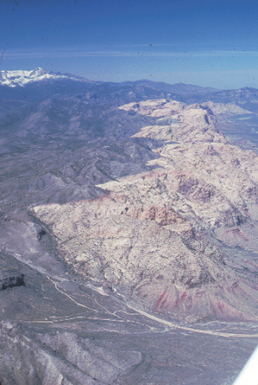
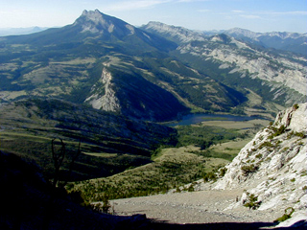
What kind of fault would end up like this – one side thrust up over the other?

Slide 16
Thrust fault

Slide 17
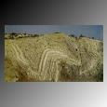
Fold, fault or fracture?

Slide 18
Fold, of course!

Slide 19
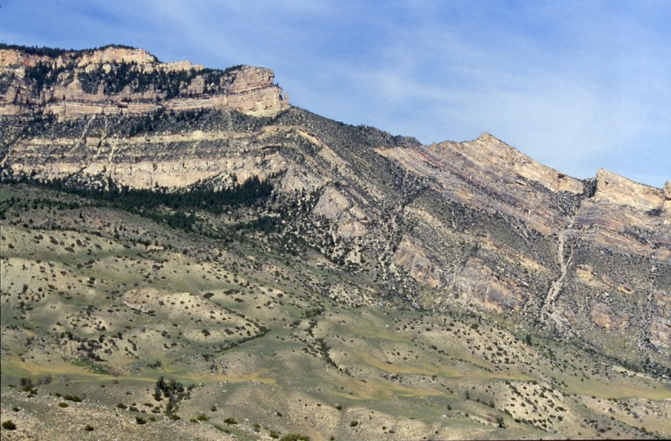
What would you call a single-limbed fold like this?
Click here for a hint.

Slide 20
Single = mono

Slide 21
That’s right, monocline!

Slide 22
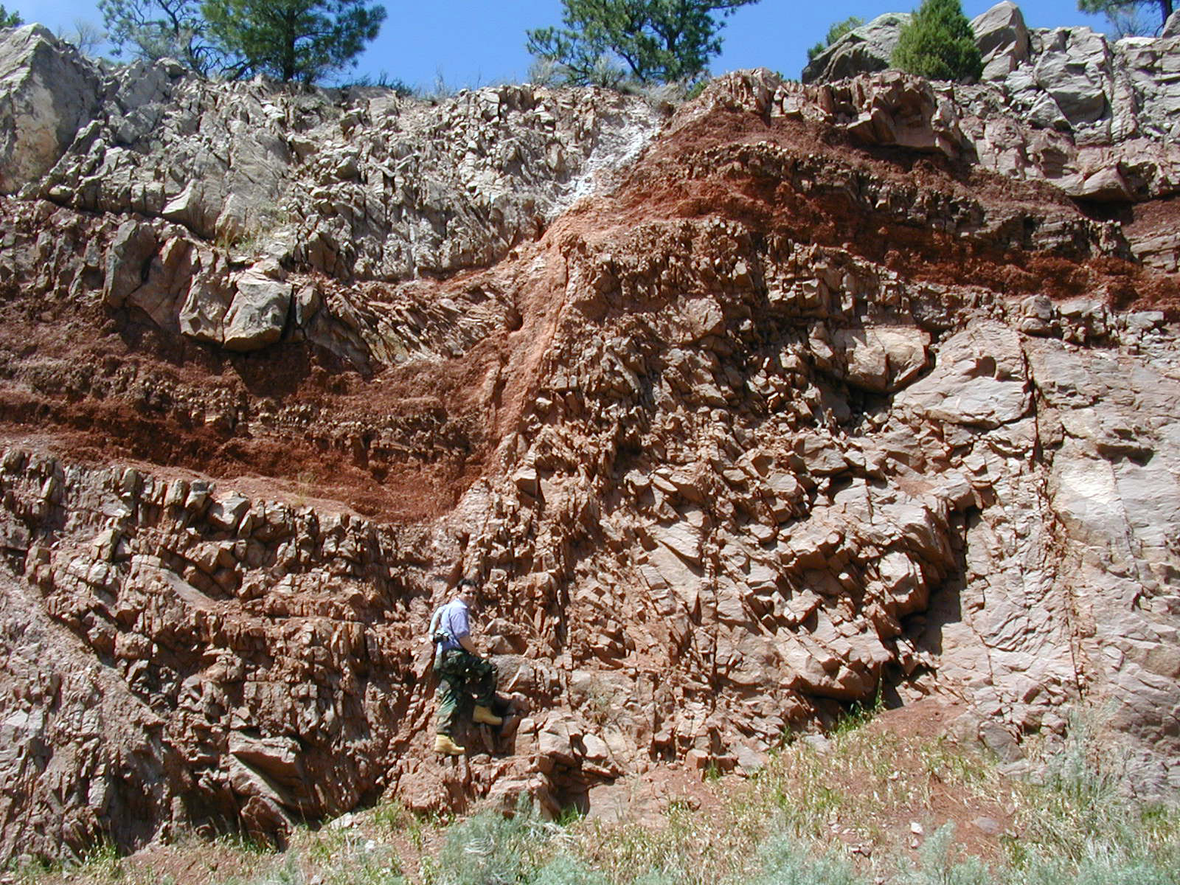
Normal, reverse, thrust or recumbent?

Slide 23
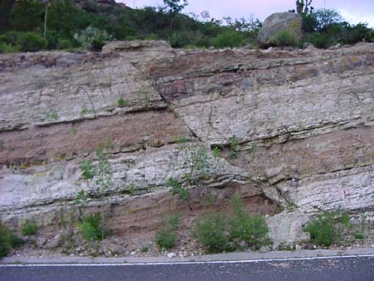
The previous deformation is the same as this one, which is ….

Slide 24
A normal fault

Slide 25
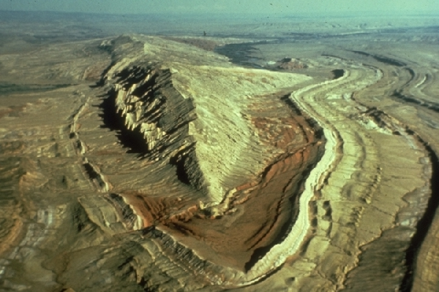
What kind of anticline results in this ridge and the associated hogbacks?
Click here for a hint.

Slide 26
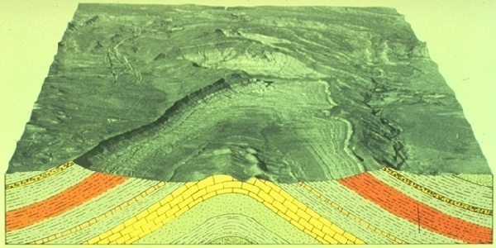

Slide 27
A plunging anticline

Slide 28
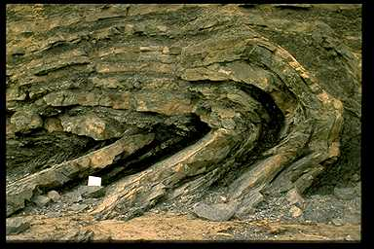
What is the special name for an extreme fold such as this?

Slide 29
Recumbent

Slide 30
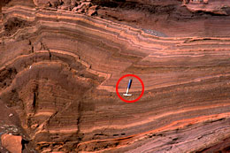
Normal, reverse, strike-slip, or obtuse fault?

Slide 31
Reverse fault – the hanging wall moved up the foot wall!

Slide 32
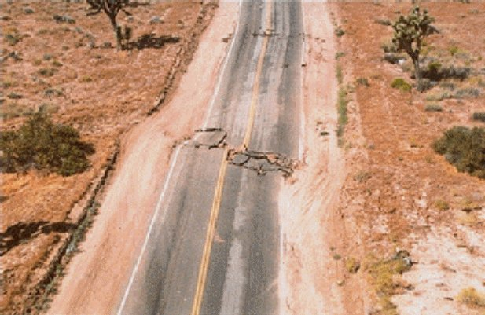
What kind of slip is exhibited here?

Slide 33
Strike-slip

Slide 34
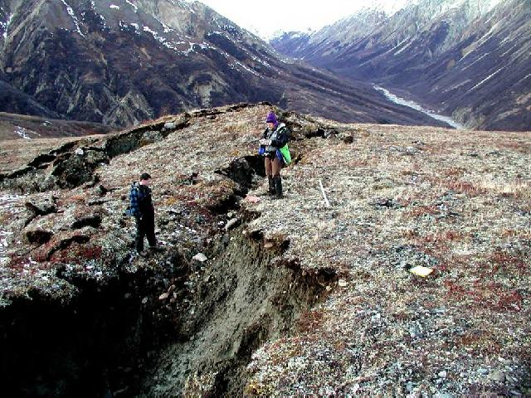
The face formed on this footwall is known as what?
Click here for another example.

Slide 35
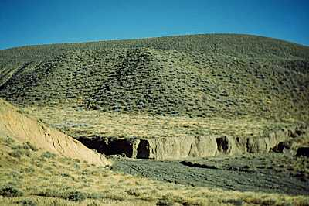
We’re talking about the cliff-like wall on the fault line.

Slide 36
It’s a fault scarp!

Slide 37
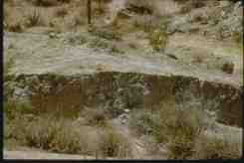
If you get both vertical and horizontal displacement, what kind of fault is that?
Want to see another example? Click here.

Slide 38
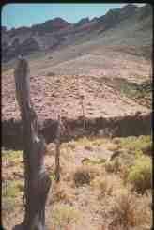

Slide 39
It’s called an oblique-slip fault.

Slide 40
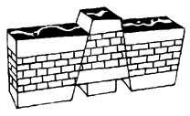
An upthrust block between parallel faults is known as what?

Slide 41
A horst is a horst, of courst, of courst! Special acknowledgement to Mr. Ed of television fame!

Slide 42
How did you do on the vocabulary for geologic deformation? These are the terms that you may need to know for the next test.

Slide 43
This powerpoint was kindly donated to www.worldofteaching.com
http://www.worldofteaching.com is home to over a thousand powerpoints submitted by teachers. This is a completely free site and requires no registration. Please visit and I hope it will help in your teaching.

